Slide 1
Series

Slide 2
Opportunity
CTV market is de-growing
There is a stronger need among middle/lower middle class to enter this segment – Wall Hanging TV
Up-gradation (Social & technology)
Entertainment enhancement
Top 3 brands Sony, SS & LG are moving away from this segment
Regional Players lacks infrastructure, capability & Credibility to pose any challenge.
Videocon’s Opportunity
Brand Trust & Credibility
Affordability

Slide 3
Business Objective
Increase Market share 12% →22% by targeting new set of customers
Target new market (Increase Penetration)
Strengthen Distribution network by acquiring new Trade partners
Maintain sales volume during lean period (post Diwali)

Slide 4
Benefits of Welcome Series
Fix Price series, no scheme
Attractive Price point
MOP maintain
Available in 20” and 40” (80%) which is highest selling
Available in 150L, 170L, 190L and 307 L REF DC which is 70% market
Purpose of Welcome Series
Improve the sales
Volume Driver
To convert Toshiba, Onida and Haier Brand customer
Increase Dealer Network
Start business with FOMT

Slide 5
Features - FPD
PICTURE QUALITY
Resolution:
- HD (1366 x 768)
- HD+ (1600 x 900)
- FHD (1920 x 1080)
HD implies a horizontal resolution of 1366 pixels. High Definition refers to video having
resolution substantially higher than traditional televisions.
HD+ implies a horizontal resolution of 1600 pixels.
FHD implies a horizontal resolution of 1920 pixels. This creates a frame resolution of
1920x1080 pixels which is 2,073,600 pixels in total.
All 3 types of resolutions are available in Videocon
Welcome Series
HD Ready
HD +
Full HD
1080P

Slide 6
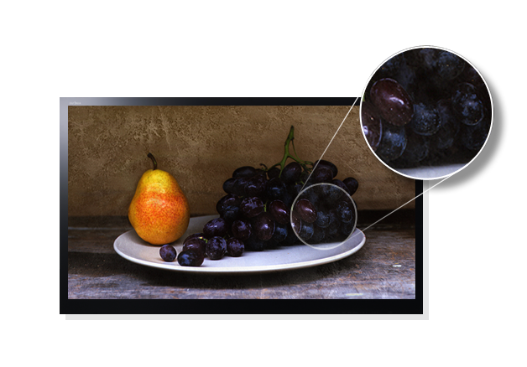
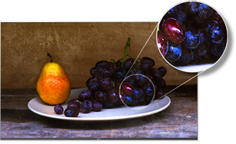
Features - FPD
16.7 M
Colors:
Videocon Welcome Series will have 16.7 Million Display Colors which will give a better
picture quality and clarity of another level.
VIDEOCON LED

Slide 7
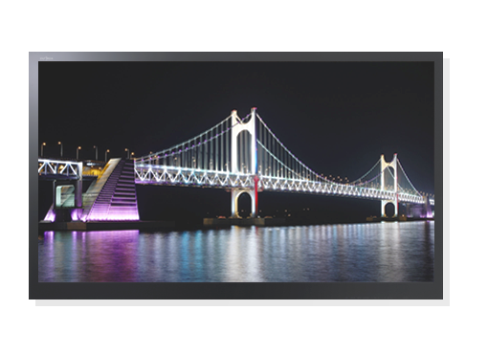
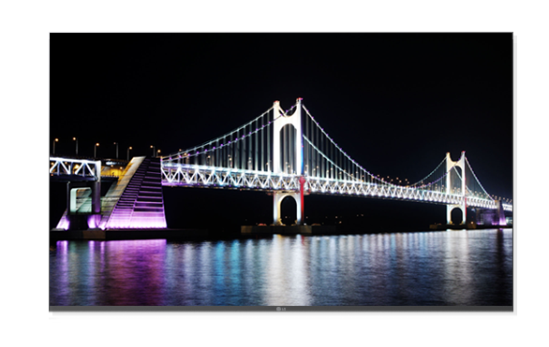
Features - FPD
Contrast Ratio:
High contrast ratio gives the darkest black level that are insanely dark and rich making the
white level stark and bright. The colors are vibrant and simply radiate off the screen with
an overall experience which is stunning and spectacular.
High Contrast Ratio
VIDEOCON LED

Slide 8
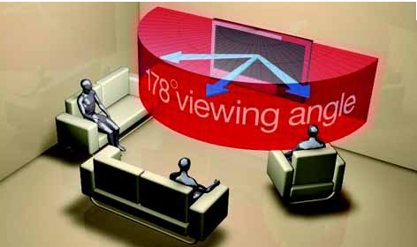
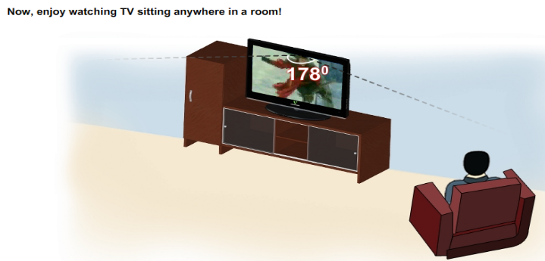
Features - FPD
VIEWING ANGLE
A viewing angle is the angle from which the image on the TV can be viewed. All TVs can be viewed
when you are right in front of it, but since all viewers cannot sit right in front of the TV and have to sit
around it, the viewing angle parameter becomes very important.

Slide 9
Features - FPD
SOUND QUALITY:
A very good sound quality as compared to normal LED’s.
Music Mode - 4 Music Mode (User, Speech, Standard, Music)
Auto Volume Leveller
CONNECTIVITY:
USB – 1 x USB (MPEG). Videocon Welcome series are built-in with USB 2.0 version which can play videos, songs and pictures. It is fast enough to transfer data.
HDMI – 1 x HDMI (Smart connect). High Definition Multimedia Interface will help in transferring uncompressed video data.
1 AV In
1 AV Out
PC Connectivity (VGA In)

Slide 10
Features - FPD
Eco vision technology has been designed to save energy and power.
It avoids eye strain while watching television . Videocon Welcome Series has
Eco vision in 20”, 22”, 24” and 32”.
Let your daily life be fresher and healthier
than ever with our innovative cooling
performance, maintaining optimum freshness.
Energy Saving

Slide 11
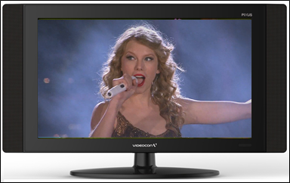
Unique Features - FPD
Special Zoom Mode: The picture gets zoom from top end whereas the Bottom will remain the same so that it can catch the captions. (For Eg: For news channels)
Normal Zoom Mode
Special Zoom Mode
News Captions

Slide 12
Unique Features - FPD
Brightest Picture: Videocon LED’s are more bright in comparison to normal LED’s. It has an appropriate luminance of a visual target. The range has been finely defined below:
Size | Videocon LED | Normal LED | % increase
32” | 350-370cd | 300cd | 17%
24”-22” | 270-300cd | 200cd | 35%

Slide 13
Punch Line
Value for money

Slide 14
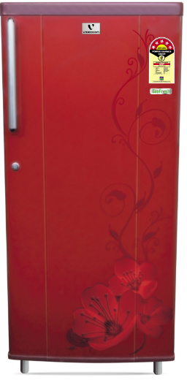
Key Reasons to Buy - REF
Energy Saving
Hygiene
Star rated products as per 2014 BEE guidelines
Detachable antibacterial door gasket
Others
Unique capacity – 150Ltr & 170Ltr.
Stabilizer free operation
Deodorizer
Freshness
5 years Warranty
Fast Cooling
In-situ foamed door
Stylish
Design
Powerful Compressor
Wire-shelves

Slide 15
Features - REF
ENERGY SAVING
Star Rating: 3, 4 & 5 star rated products as per 2014 BEE guidelines – Optimizes the electricity consumption and saves energy
Stabilizer free operation: Works efficiently under voltage fluctuation
FRESHNESS
Retains the food freshness by fast cooling
High quality Foam used which keeps the coolness intact and thermally sealed system ensures the high cooling effect inside the refrigerator, which ensures that inside the fridge, the coolness is maintained perfectly and each stored item gets balanced cooling
Powerful Compressor which provides highly efficient Cooling even in high temperature

Slide 16
Features - REF
FRESHNESS
Retains the food freshness by fast cooling
High quality Foam used which keeps the coolness intact and thermally sealed system ensures the high cooling effect inside the refrigerator, which ensures that inside the fridge, the coolness is maintained perfectly and each stored item gets balanced cooling
Powerful Compressor which provides highly efficient Cooling even in high temperature
Freshness

Slide 17
Features - REF
HYGIENE
The presence of anti-bacterial gasket prevents entry of bacteria or fungal causing elements. Special Removable and cleanable gasket inhibits the growth of unwanted fungal at doors
The Powerful deodorizer keeps foul odour at bay such that your refrigerator keeps smelling fresh all day long
WARRANTY
1 year comprehensive warranty + 4 year additional warranty on compressor
UNIQUE CAPACITY
Videocon gives the unique capacity range such as 150L and 170L which is not available with the competition
WIRE SHELVES
For giving extra space to store food

Slide 18
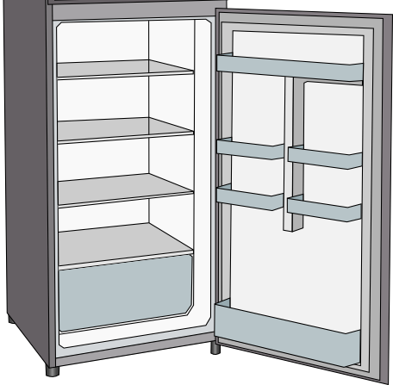
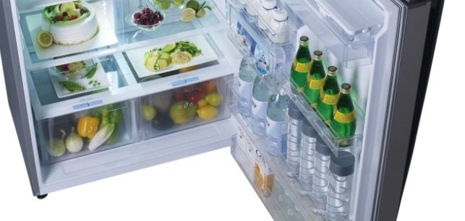
Organized Space - REF
Egg Tray
Ice tray
Shelf Utility
Wired Shelves/ Toughened glass
Shelf Bottles
Fruit and Veg Box
A separate Basket on a pull out tray for easy retrieval and
access to fruits/ soft vegetables

Slide 19
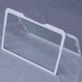
Stylish Design - REF
Toughened Glass Shelves
Customer Benefit:
Shelves made of strengthened glass are capable
of carrying very heavy utensils.
It can withstand a load of Up to 100Kg
Stylish
Design

Slide 20
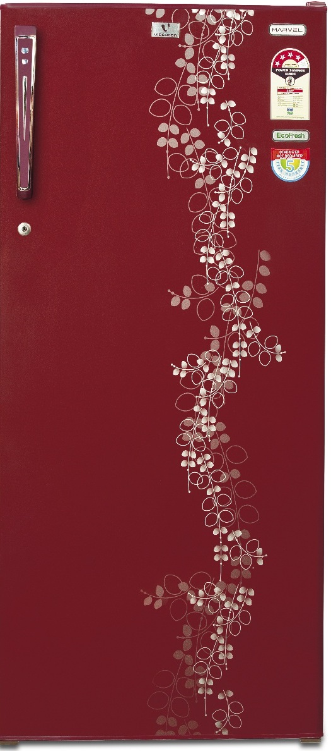
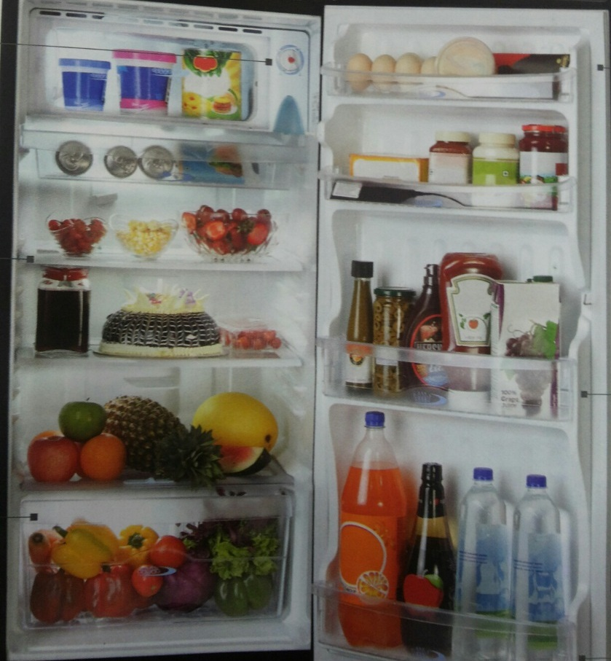
Stylish Design - REF
Stylish
Design
Painted/ PCM Finish
Stylish
Design

Slide 21
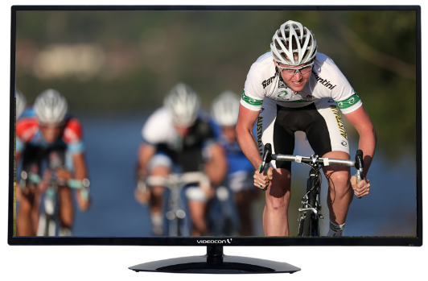
LED
IVD40FZ-A
FULL HD
MEGA CONTRAST
16.7 MILLION DISPLAY Colors
2X HDMI
1XUSB 2.0(MOVIE,JPEG,MP3)
5 BAND EQUALIZER
BASS/TREBLE
SCREEN SIZE :
40”
Finish/Looks
RESOLUTION :
1920 x 1080
POWER SUPPLY :
230V / 50Hz AC
H & C Glossy black

Slide 22
LED
IVC32F2-A
HD READY
MEGA contrast
16.7 MILLION DISPLAY Colors
1x HDMI Ver1.4
smart connect (hdmi-cec)
1XUSB 2.0(MOVIE,Jpeg,MP3)
ENERGY METER
Family favorite
Eco logic
SCREEN SIZE :
32”
Finish/Looks
RESOLUTION :
1366 x 768
POWER SUPPLY :
230V / 50Hz AC
H & C Glossy black

Slide 23
LED
IVC24F2-A
FULL HD
MEGA contrast
16.7 MILLION DISPLAY Colors
1x HDMI Ver1.4
smart connect (hdmi-cec)
1XUSB 2.0(MOVIE,Jpeg,MP3)
ENERGY METER
Family favorite
Eco logic
SCREEN SIZE :
24”
Finish/Looks
RESOLUTION :
1920 x 1080
POWER SUPPLY :
230V / 50Hz AC
H & C Glossy black

Slide 24
LED
IVC22F2-A
FULL HD
MEGA contrast
16.7 MILLION DISPLAY Colors
1x HDMI Ver1.4
smart connect (hdmi-cec)
1XUSB 2.0(MOVIE,Jpeg,MP3)
ENERGY METER
Family favorite
Eco logic
SCREEN SIZE :
22”
Finish/Looks
RESOLUTION :
1920 x 1080
POWER SUPPLY :
230V / 50Hz AC
H & C Glossy black

Slide 25
LED
IVC20F2-A
HD +
MEGA contrast
16.7 MILLION DISPLAY Colors
1x HDMI Ver1.4
smart connect (hdmi-cec)
1XUSB 2.0(MOVIE,Jpeg,MP3)
ENERGY METER
Family favorite
Eco logic
SCREEN SIZE :
20”
Finish/Looks
RESOLUTION :
1600 x 900
POWER SUPPLY :
230V / 50Hz AC
H & C Glossy black

Slide 26
Welcome Series
REF LINE UP
VIDEOCON

Slide 27
ALL INDIA – BHARAT SERIES
Features
IAB163
Specifications
1. 3 Star BEE Rating
2. Painted Finish
3. Wire Shelves
4. Recessed Handle
5. In-situ Foamed Door
6. Anti Bacterial Door Gasket (Removable Type)
7. Opaque Accessories
8. Cover Crisper-Glass
9. Door Lock
2014 | MODEL NO | VAB163
 | BRAND NAME | VIDEOCON
 | PLANT | AUR
PHYSICAL BRIEF | PET NAME | SMART MASTER
 | CAPACITY (L) | 150
FUNCTIONAL | STAR RATING | 3
 | GASKET TYPE | REMOVABLE
 | ANTI BACTERIAL GASKET | YES
 | INSITU DOOR FOAM | YES
 | TRAY FRESH ROOM | OPAQUE (HIPS, with Sarration)
 | ICE TRAY | 1 NOS
 | SHELF | 2-WIRE SHELVES (without trim)
 | EGG TRAY | OPAQUE (HIPS)
 | COVER CRISPER | GLASS
 | CRISPER | OPAQUE (HIPS)
 | SHELF BOTTLE | MOULDED DOOR SUPPORT(OPAQUE)
 | SHELF UTILITY | MOULDED DOOR SUPPORT(OPAQUE)
 | FREEZER DOOR | OPAQUE (HIPS) (without back cover)
 | DOOR FINISH | PAINTED
 | HANDLE TYPE | RECESSED
MISC | CONDENSER | EXTERNAL
 | LOCK | YES
 | STICKERS | BEE / PET NAME / ECOFRESH
DOOR COLOR |  | BURGUNDY RED,SILKY GREY
CABINET COLOR |  | BURGUNDY RED,SILKY GREY
END CAP COLOR |  | BURGUNDY RED,SILKY GREY
Technical Specification
Gross Capacity
150 L
Power Supply
220 - 240V / 50 Hz
Product Dimension (mm)
524 W * 620 D * 986 H
Available Colour :
Burgundy Red
Silky Grey

Slide 28
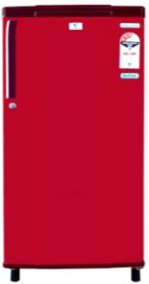
WEST – DELUXE SERIES
IAE183 (Chill Mate Series)
Features
Specifications
2014 | MODEL NO | VAE183
 | BRAND NAME | VIDEOCON
 | PLANT | AUR
PHYSICAL BRIEF | PET NAME | CHILL MATE
 | CAPACITY (L) | 170
FUNCTIONAL | STAR RATING | 3
 | GASKET TYPE | REMOVABLE
 | ANTI BACTERIAL GASKET | YES
 | INSITU DOOR FOAM | YES
 | TRAY FRESH ROOM | OPAQUE (HIPS, with Sarration)
 | ICE TRAY | 2 NOS
 | SHELF | 2-WIRE SHELVES (without trim)
 | EGG TRAY | OPAQUE (HIPS)
 | COVER CRISPER | GLASS
 | CRISPER | OPAQUE (HIPS)
 | SHELF BOTTLE | MOULDED DOOR SUPPORT(OPAQUE)
 | SHELF UTILITY | MOULDED DOOR SUPPORT(OPAQUE)
 | FREEZER DOOR | OPAQUE (HIPS) (without back cover)
 | DOOR FINISH | POWDER COATED
 | HANDLE TYPE | IKON
MISC | CONDENSER | EXTERNAL
 | LOCK | YES
 | STICKERS | BEE / PET NAME / ECOFRESH
DOOR COLOR |  | BURGUNDY RED,SILKY GREY,LOTUS PINK
CABINET COLOR |  | BURGUNDY RED,SILKY GREY,LOTUS PINK
3 Star Rating
Stabilizer free Operation
3. Painted Door Finish
4. Opaque Interiors
Anti Bacterial Removable
Door Gasket
6. Door Lock
1+4 Yrs. Warranty
Ikon Handle
Technical Specification
Gross Capacity
170L
Power Supply
230V / 50 Hz AC
LB
Product Dimension (mm)
524*650*1027
Available Color :
Silky Grey Burgundy Red Lotus Pink

Slide 29
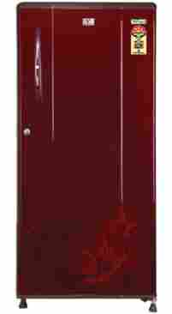
WEST – PREMIUM SERIES
Features
IAP224T
Vertical Door Emboss
PCM
Transparent Accessories,
Toughened Shelves
Cover Crisper-GPPS Transp.
External Condenser
External Bar handle
4 * BEE Rating
2014 | MODEL NO | VAP224T
 | BRAND NAME | VIDEOCON
 | PLANT | AUR
 |  | West
PHYSICAL BRIEF | PET NAME | MARVEL
 | CAPACITY (L) | 215
FUNCTIONAL | STAR RATING | 4
 | GASKET TYPE | REMOVABLE
 | ANTI BACTERIAL GASKET | YES
 | INSITU DOOR FOAM | YES
REF COMPARTMENT | TRAY FRESH ROOM | TRANSPARENT (GPPS, with Sarration)
 | ICE TRAY | 2 NOS
 | SHELF | 3-TOUGHNED GLASS
 | DEODORIZER | YES
 | EGG TRAY | TRANSPARENT (GPPS)
 | COVER CRISPER | TRANSPARENT (GPPS)
 | CRISPER | TRANSPARENT (GPPS)
 | SHELF BOTTLE | MOULDED BIG TRANSP. -02 NOS.
 | SHELF UTILITY | MOULDED SMALL TRANSP. -02 NOS.
 | FREEZER DOOR | GPPS (TRANSPARENT) (with back cover)
 | DOOR FINISH | PCM
 | HANDLE TYPE | BAR
MISC | CONDENSER | EXTERNAL
 | LOCK | YES
 | STICKERS | BEE / PET NAME / ECOFRESH
DOOR COLOR |  | SILVER IVY, BLACK IVY
CABINET COLOR |  | DARK GREY,SILKY GREY
Technical Specification
Capacity
190 L
MP
Power Supply
220- 240V / 50 Hz AC
Product Dimension (mm)
524 W * 650 D * 1250 H
Black Ivy
Silver Ivy
Notes:
29

Slide 30
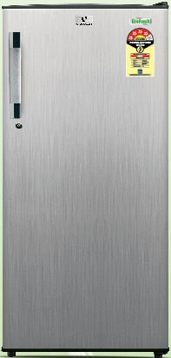
Features
ICP325TB (Marvel Series)
5 Star Rating
Stabilizer free Operation
3. PCM Finish
4. Transparent Interiors
Anti Bacterial Removable
Door Gasket
6. Door Lock
1+4 Yrs. Warranty
Socket Bar Handle
2014 | MODEL NO | VCP 325TB
 | BRAND NAME | VIDEOCON
PHYSICAL BRIEF | BRAND PET NAME | ECO FRESH
 | PET NAME | MARVEL
 | CAPACITY (L) | 310
 | STAR RATING | 5
FUNCTIONAL | GASKET TYPE | REMOVABLE
 | ANTI BACTERIAL GASKET | YES
 | INSITU DOOR FOAM | YES
 | TRAY FRESH ROOM | HIPS- OPAQUE (with insulation)
 | TRAYFRESH ROOM DOOR | GPPS TRANSPERENT
REF COMPARTMENT | ICE TRAY | 2 NOS OPAQUE
 | SHELF (WHITE COLOUR TRIM) | 3-WIRE SHLEVES (with trim)
 | DEODORIZER | YES
 | EGG TRAY | 1GPPS - TRANSPERANT
 | COVER CRISPER | GPPS - TRANSPERANT
 | CRISPER | GPPS - TRANSPERANT
 | SHELF BOTTLE | 3GPPS-TRANSPERENT
 | SHELF UTILITY | 2GPPS - TRANSPERANT
 | FREEZER DOOR | HIPS (with back cover)
 | DOOR FINISH | PCM
EXTERIOR | HANDLE TYPE | SOCKET BARHANDLE
 | CONDENSER | CONCEALED
 | LOCK | YES
 | STICKERS | BEE / PET NAME
DOOR COLOR |  | MARON IVY, BLACK HAIRLINE
CABINET COLOR |  | BURGUNDY RED, DARK GRAY
Technical Specification
Gross Capacity
307L
Power Supply
230V / 50 Hz AC
Product Dimension (mm)
570*640*1540
Black Hairline
Maroon Ivy

Slide 31
Thank You

