Slide 1
KEL REF PRM
2015

Slide 2
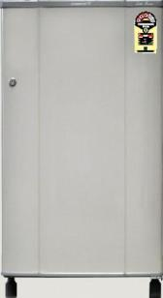
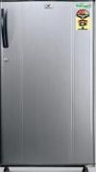
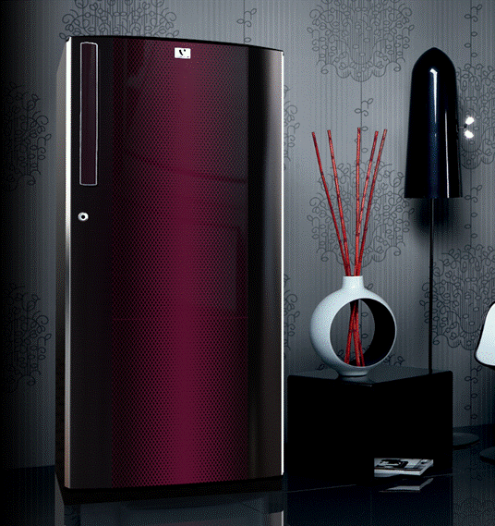
DC Refrigerator Lineup
CAP.
MODEL
2015
FEATURES
REMARK
Burgundy Red
3 Star Rating
Painted Door Finish
Recessed Handle
HIPS Accessories
Continue
150 L
Discontinue
KW163E
Discontinue SG
Silver hairline
3 Star Rating
PCM Door Finish
Wired Shelves
GPPS Accessories
Continue- Jan
150 L
EOL - March
Gradient Series Discontinued
KW163P
Gulmohar Series
3 Star Rating
PCM Door Finish
Toughened glass
GPPS Accessories
Continue- April
150 L
Pixel Series Discontinued
Discontinue- March
KW163PT

Slide 3

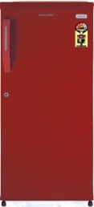
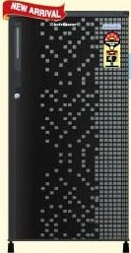
DC Refrigerator Lineup
CAP.
MODEL
2015
FEATURES
REMARK
Burgundy Red/ Silky Grey
3 Star Rating
Powder coated Finish
Chrome Handle
HIPS Accessories
Wire Shelves
170 L
Continue- Jan
KW183E
Burgundy Red/ Silky Grey
3 Star Rating
Powder coated Finish
HIPS Accessories
Wire Shelves
Continue- Jan
170 L
KN183E
Geometry Series
3 Star Rating
PCM Door Finish
Wired Shelves
HIPS Accessories
Continue- March
170 L
Two Tone Series Discontinued
EOL - March
KW183P

Slide 4
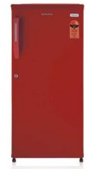
DC Refrigerator Lineup
CAP.
MODEL
2015
FEATURES
REMARK
3 Star Rating
PCM Door Finish
Toughened glass
GPPS Accessories
170 L
Continue- March
Gulmohar Series
KW183PT
Burgundy Red
3 Star Rating
Painted Finish
Wire Shelves
Continue
190 L
EOL - March
Gradient Series Discontinued
KW203E
Burgundy Red
2 Star Rating
Powder Finish
Wired Shelves
Insta Handle
HIPS Accessories
Continue
190 L
EOL - March
Gradient Series
KC202E

Slide 5
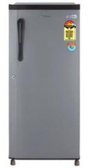
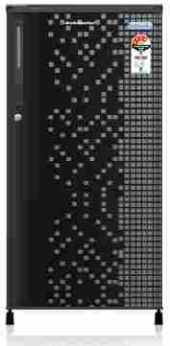
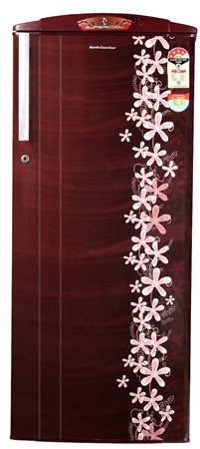
DC Refrigerator Lineup
CAP.
MODEL
2015
FEATURES
REMARK
3 Star Rating
Painted Finish
Wire Shelves
S Type Handle
190 L
Burgundy Red/ Silky Grey
Continue- Jan
KS203E
Geometry & Gulmohar
4 Star Rating
PCM Door Finish
Toughened glass
Bar Handle
Continue-March
190 L
Discontinue- March
Two Tone Series Discontinued
KW204PT
Milange/Aster/Pastel
4 Star Rating
VCM
Toughened glass
Base Stand
GPPS Accessories
Continue-Jan
190 L
Discontinue-March
Lavender Milange
KW204LST

Slide 6
DC Refrigerator Lineup
CAP.
MODEL
2015
FEATURES
REMARK
Hairline Series
3 Star Rating
PCM Door Finish
Wired Shelves
Continue- March
190 L
Pixel Series Discontinued
EOL - March
KW203P
4 Star Rating
PCM Door Finish
Wired Shelves
HIPS Accessories
Continue- March
Geometry Series
190 L
EOL - March
KC204P
Maroon hexa
Geometry Series
5 Star Rating
PCM Door Finish
Toughened glass
GPPS Accessories
Continue- March
190 L
EOL - March
Milange Series
KC205PT

Slide 7
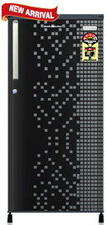
DC Refrigerator Lineup
CAP.
MODEL
2015
FEATURES
REMARK
Milange / Aster Series
5 Star Rating
PCM
Toughened glass
GPPS Accessories
190 L
EOL - March
KC205LT
5 Star Rating
VCM
Toughened glass
Base Stand
Cool Charger
Pastel Series
Continue- March
190 L
KC205LST
5 Star Rating
VCM
Toughened glass
Continue- March
190 L
Milange Series
KS205LT

Slide 8
DC Refrigerator Lineup
CAP.
MODEL
2015
FEATURES
REMARK
Hairline Series
3 Star Rating
PCM Door Finish
Wired Shelves
Cool Charger
190 L
Continue-March
KW203PC
Hairline Series
3 Star Rating
PCM Door Finish
Wired Shelves
190 L
Continue- March
KS203P
4 Star Rating
PCM Door Finish
Wired Shelves
190 L
EOL- March
Maroon Pixel & Wine Hexa
KS204P

Slide 9
DC Refrigerator Lineup
CAP.
MODEL
2015
FEATURES
REMARK
Geometry & Gulmohar
4 Star Rating
PCM Door Finish
Toughened glass
190 L
Continue- Feb
KS204PT
Geometry Series
5 Star Rating
PCM
Toughened glass
GPPS Accessories
190 L
Continue- Feb
KS205PT
Milange / Aster/ Pastel
5 Star Rating
VCM
Toughened glass
Base Stand
Cool Charger
Continue- Pastel - March
190 L
KS205LT

Slide 10
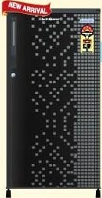
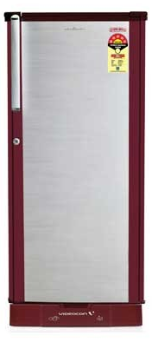
DC Refrigerator Lineup
CAP.
MODEL
2015
FEATURES
REMARK
Dual Tone & Hexa Series
3 Star Rating
PCM Door Finish
Toughened glass
GPPS Accessories
215 L
EOL- March
KW223PT
Geometry & Gulmohar
4 Star Rating
PCM Door Finish
Toughened glass
Bar Handle
GPPS Accessories
215 L
Continue- March
KW224PT
Milange/ Pastel
4 Star Rating
PCM
Toughened glass
Base Stand
Bar Handle
215 L
Continue- March
KW224LST

Slide 11
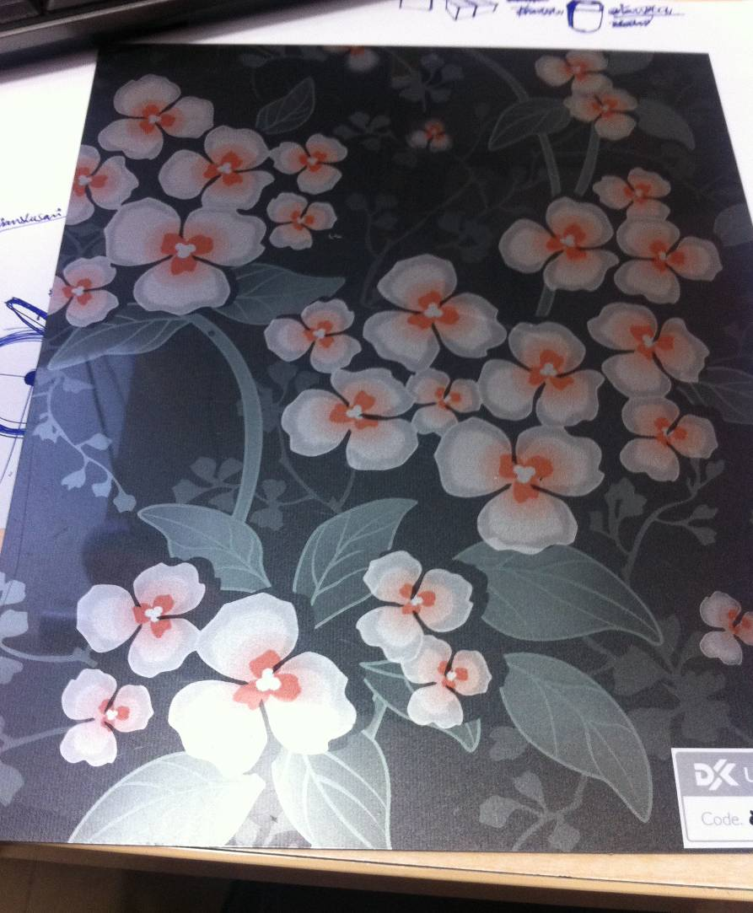
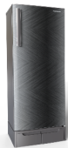

DC Refrigerator Lineup
CAP.
MODEL
2015
FEATURES
REMARK
Pastel Series
3 Star Rating
VCM
Toughened glass
GPPS Accessories
Continue- Feb
225 L
Milange Series
Discontinue- March
KF233LT
5 Star Rating
New Series
Toughened glass
Geometry-w/o Water Dispenser
Pastel –with water dispenser
Geometry & Pastel
Continue-
Geo – March
Pastel - TBD
245 L
KO256LT
Gulmohar Series
4 Star Rating
PCM Door Finish
Toughened glass
Bar Handle
307 L
Continue- March
KC324PT

Slide 12


FF Refrigerator Lineup
CAP.
MODEL
2015
FEATURES
REMARK
Gulmohar Series
2 Star Rating
PCM Finish
Toughened Glass
190 L
Continue- March
KP202P
Gulmohar Series
2 Star Rating
PCM Finish
Toughened Glass
235 L
Continue- March
KP242P
3 Star Rating
PCM Door Finish
Toughened glass
DC inverter Compressor
240 L
Gulmohar Series
Continue-March
KS253L

Slide 13
FF Refrigerator Lineup
CAP.
MODEL
2015
FEATURES
REMARK
1 Star Rating
PCM Door Finish
Toughened glass
GPPS Accessories
Graphite Hairline
Continue- Jan
240 L
KS251P
Gulmohar Series / Maroon Pixel
2 Star Rating
PCM Finish
Toughened Glass
240 L
Continue-Feb
KS252P
Gulmohar Series / Maroon Pixel
2 Star Rating
PCM Finish
Toughened Glass
GPPS Accessories
280 L
Continue- Feb
KS292P

Slide 14
FF Refrigerator Lineup
CAP.
MODEL
2015
FEATURES
REMARK
3 Star Rating
PCM Door Finish
Toughened glass
DC inverter Compressor
Gulmohar Series
280 L
Continue- March
KS293L
270 L
TBD
TBD
KO284L
320 L
TBD
TBD
KO334L

Slide 15
Thank You
.
© 2014 KAIL Limited

