Slide 1
AIRCONDITIONER ERROR CODES

Slide 2
Sr. No | Problem Description | Fault Message/Error
Window -- AC
1 | Room Temp Sensor Faulty/ cable cut | E1
2 | Coil Temp Sensor Faulty/ cable cut | E2
SAC -- Midea
1 | Coil Temp Sensor Faulty/ cable cut | Green Led blink along with operation LED
2 | Room Temp Sensor Faulty/ cable cut | Green Led blink along with operation LED
3 | IDU Motor Faulty/ Cable cut/ feedback not received | Only Green Led blink after 1 min
SAC Galanz/VIL In-house
1 | Coil Temp Sensor Faulty/ cable cut | F8
2 | IDU Motor Faulty/ Cable cut/ feedback not received | F6
3 | Room Temp Sensor Faulty/ cable cut | F7
SAC -- GREE
1 | Blower Motor Error | H6
2 | Coil Sensor Error | F2
3 | Temp Sensor Error | F1
4 | Jumper Change (Check Connector 04) | C5
SAC -- TCL
1 | Blower Motor Error | E6
2 | Coil Sensor Error | E2
3 | Temp Sensor Error | E1

Slide 3
FOR CEILING MOUNTED AIR CONDITIONERS
FLASHING OF RED LIGHTS | PERFORMANCE FAULTS
1 TIME / 1SEC. | FAULTY COILS
1 TIME / 3 SEC. | COLD AIR PROTECTION (NORMAL FUNCTION)
2 TIMES / 4 SEC. | ROOM TEMP. SENSOR FAULTS
3 TIMES / 5 SEC. | FAULTY COILS
4 TIMES / 6 SEC. | OUT DOOR UNIT (OVERFLOW, ELECTRIC NETWORK VOLTAGE FAULTS)
5 TIMES / 7 SEC. | FROST RESISTANCE PROTECTION (NORMAL FUNCTION)
7 TIMES / 9 SEC. | ABNORMITY OF OUT FEED BACK
8 TIMES / 10 SEC. | OVERHEATING PROTECTION
9 TIMES / 11 SEC. | WATER PUMP FAULTS

Slide 4
FOR CEILING MOUNTED AIR CONDITIONER (VA2400SPCA) OLD MODEL
FLASHING OF RED LIGHTS | PERFORMANCE FAULTS
2 TIMES / 4 SEC. | FAULTY COILS
3 TIMES / 5 SEC. | ROOM TEMP. FAULTS
4 TIMES / 6 SEC. | WATER PUMP FAULTS
6 TIMES / 8 SEC. | FROST RESISTANCE PROTECTION
7 TIMES / 9 SEC. | OUTDOOR UNIT (OVERFLOW, ELECTRIC NETWORK VOLTAGE FAULTS)
8 TIMES / 10 SEC. | OVER HEATING PROTECTION
FOR FLOOR STANDING AIR CONDITIONERS
FAILURE CODE | CAUSE OF FAILURE
E2 | ROOM TEMP. FAILURE
E3 | PIPE TEMP. FAILURE
E4 | IMPROPER OPERATION OF OUTDOOR UNIT
E8 | FROSTING
E7 | EXTERNA FEEDBACK FAILURE
E8 | OVERHEAT PROTECTION

Slide 5
Self Diagnosis for Galanz make Wall Mounting Models
VFD/LEV Display Error Code | Malfunction Reason
F6 or FF 06 | Indication of the malfunction of PG motor
F7 or FF 07 | Indication of the malfunction of indoor temp sensor
F8 or FF 08 | Indication of the malfunction of indoor coil sensor
F9 or FF 09 | Indication of the malfunction of outdoor coil sensor
Self Diagnosis for Galanz make Floor Standing Models
VFD/LEV Display Error Code | Malfunction Reason
F1 or FF 01 | Indication of evaporator frost malfunction
F3 or FF 03 | Indication of outdoor coil overheated when cooling
F4 or FF 04 | Indication of indoor coil overheated when heating
F7 or FF 07 | Indication of the malfunction of indoor temp sensor
F8 or FF 08 | Indication of malfunction of indoor coil temp sensor
F9 or FF 09 | Indication of malfunction of Outdoor coil temp sensor
Self Diagnosis for TCL make (VAS T) Models
Error Code | Malfunction Reason
E1 | Room temp. sensor failure
E2 | Coil temp. sensor failure
E3 | Blower Motor Failure

Slide 6
ACTION TO BE TAKEN AFTER IDENTIFICATION OF ERROR

Slide 7
Fault Message | Action To Be Taken
E1 | Check room sensor wiring, Change room sensor, Track/ SMD on PCB in series of room sensor.
E2 | Check coil sensor wiring, Change coil sensor, Track/ SMD on PCB in series of coil sensor.
F8 | Check coil sensor wiring, Change coil sensor, Track/ SMD on PCB in series of coil sensor.
F6 | Check motor wires, Feedback wires, Motor Jam, Track burn/ SMD burn in series with feedback signal.
F1 | Check room sensor wiring, Change room sensor, Track/ SMD on PCB in series of room sensor.
Green Led blink along with operation LED | Check coil sensor wiring, Change coil sensor, Track/ SMD on PCB in series of coil sensor.
Green Led blink along with operation LED | Check room sensor wiring, Change room sensor, Track/ SMD on PCB in series of room sensor.
Only Green Led blink after 1 min | Check motor wires, Feedback wires, Motor Jam, Track burn/ SMD burn in series with feedback signal.

Slide 8
Fault Message | Action To Be Taken
F8 | Check coil sensor wiring, Change coil sensor, Track/ SMD on PCB in series of coil sensor.
F6 | Check motor wires, Feedback wires, Motor Jam, Track burn/ SMD burn in series with feedback signal.
F7 | Check room sensor wiring, Change room sensor, Track/ SMD on PCB in series of room sensor.
H6 | Check motor wires, Feedback wires, Motor Jam, Track burn/ SMD burn in series with feedback signal.
F2 | Check coil sensor wiring, Change coil sensor, Track/ SMD on PCB in series of coil sensor.
F1 | Check room sensor wiring, Change room sensor, Track/ SMD on PCB in series of room sensor.
C5 | Clean & Place connector 04 properly.
E6 | Check motor wires, Feedback wires, Motor Jam, Track burn/ SMD burn in series with feedback signal.
E2 | Check coil sensor wiring, Change coil sensor, Track/ SMD on PCB in series of coil sensor.
E1 | Check room sensor wiring, Change room sensor, Track/ SMD on PCB in series of room sensor.

Slide 9
ODU FAULT MESSAGES
Sr No | Problem | Red Light |  | Yellow Light |  |  | Green Light | Action To Be Taken
1 | Outdoor Evaporator Temperature Sensor Malfunction | 5 Blink |  |  |  |  |  | Check sensor wiring, Connector of Sensor, Change outdoor sensor, Track/ SMD on PCB in series of sensor.
2 | Outdoor Ambient Temperature Sensor Malfunction | 6 Blink |  |  |  |  |  | Check sensor wiring, Connector of Sensor, Change outdoor Ambient sensor, Track/ SMD on PCB in series of sensor.
3 | Over current Protection |  |  | 5 Blink |  |  |  | Check Compressor Wiring for Short Ckt, Room Sensor/ Wiring/ Connector faulty.
4 | IPM Protection |  |  | 4 Blink |  |  |  | If fault is permanent after 6 times, Check the PCB for Module Burnt/ Track Burnt/ Any damage.
5 | Communication Malfunction |  |  |  |  |  | Off | Check the Communication cable between IDU & ODU for Cable Cut/ Loose connection/ Any other High Power cable adjacent to the AC cable.
IDU FAULT MESSAGES
 | Problem |  | Error Code |  |  | Action To Be Taken
1 | Jumper Cap Malfunction |  | C5 |  |  | Clean & Place connector 04 properly.
2 | Indoor Sensor Malfunction |  | FP |  |  | Check room sensor wiring, Change room sensor, Track/ SMD on PCB in series of room sensor.
3 | Indoor Fan Failure |  | H6 |  |  | Check motor wires, Feedback wires, Motor Jam, Track burn/ SMD burn in series with feedback signal.
4 | IPM Protection |  | H5 |  |  | If fault is permanent after 6 times, Check the PCB for Module Burnt/ Track Burnt/ Any damage.

Slide 10
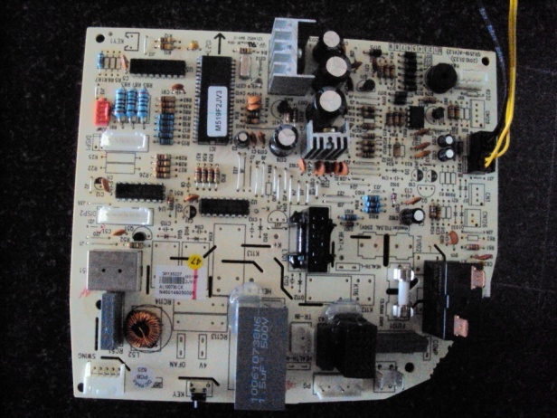
Connector 04 ( C5 Error In VPS )

Slide 11
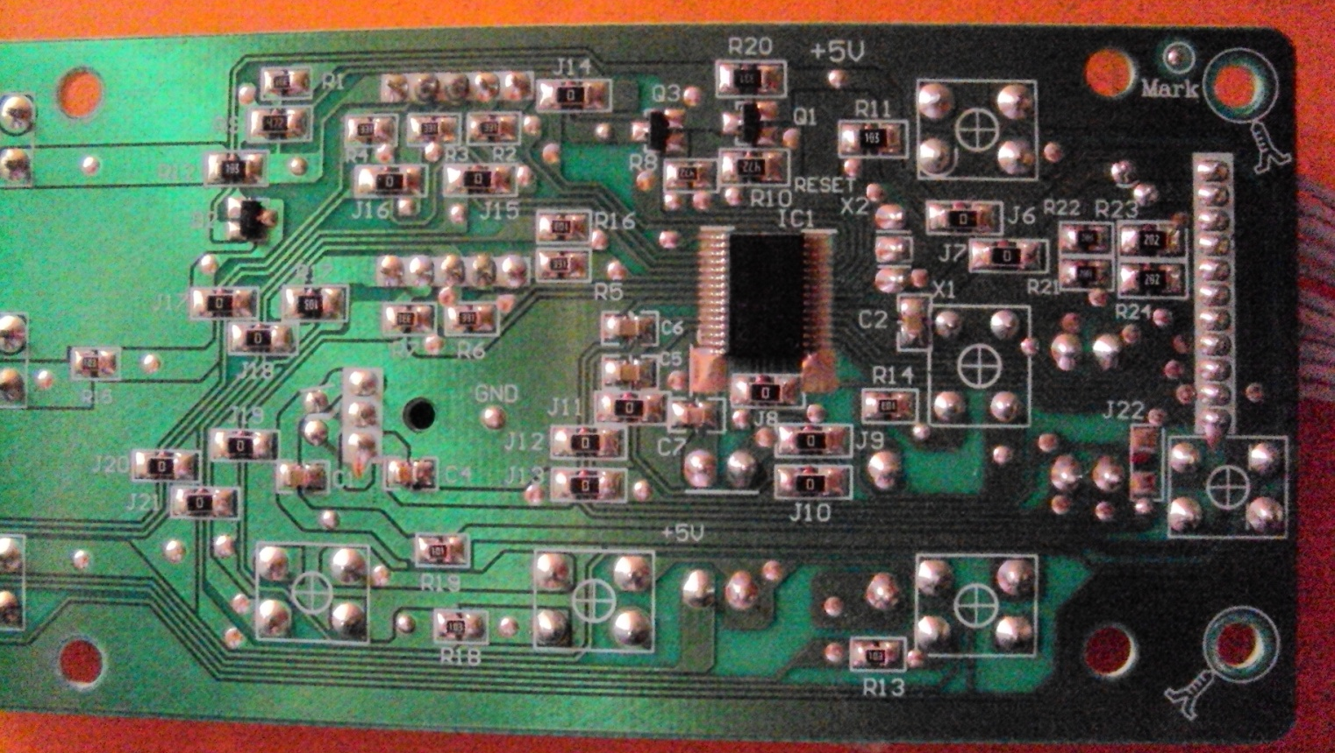
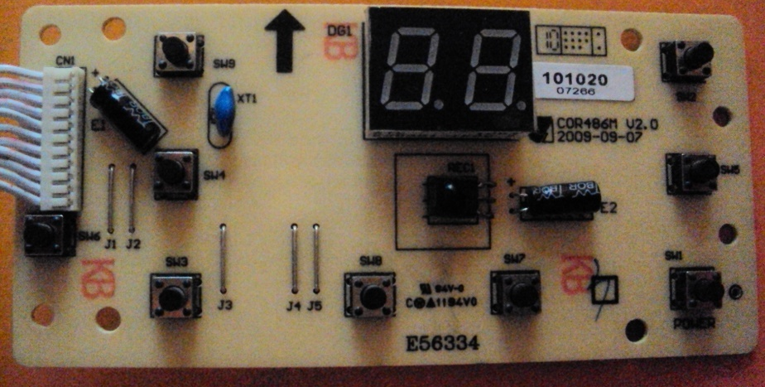
WAC Control PCB
SMD in series with Room sensor signal.

Slide 12
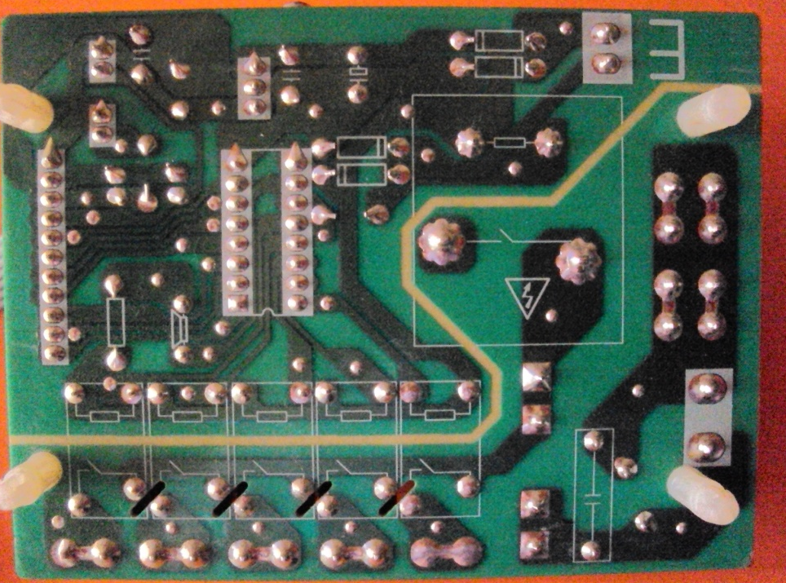
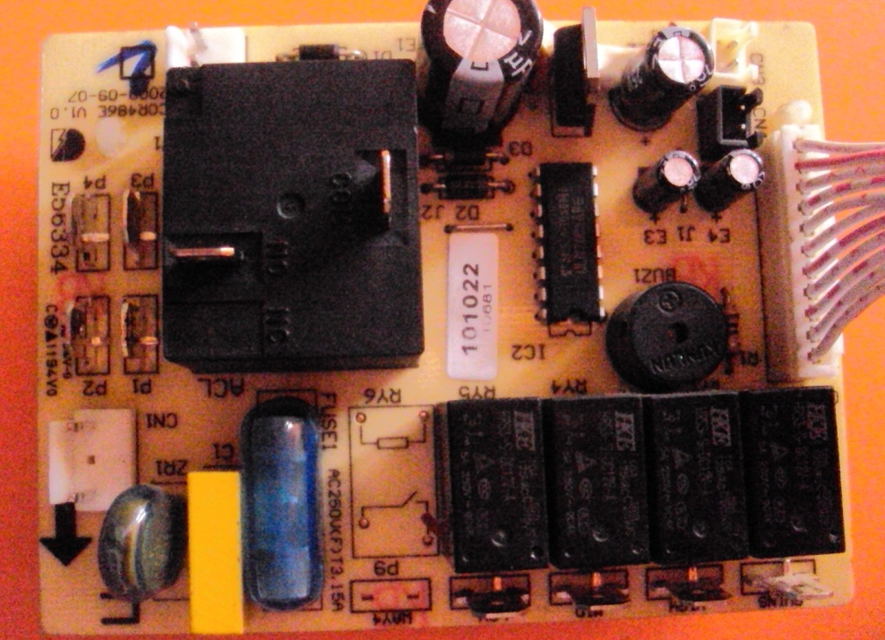
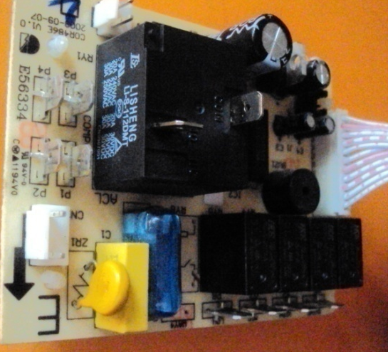
WAC Power PCB
Relays Can Damage Due To:-
1 Short Circuit in wiring
2 Wrong Wiring
3 Loose connections at Terminals ( Sparking )
VDR 10K561 ( Over-Voltage protector )

Slide 13
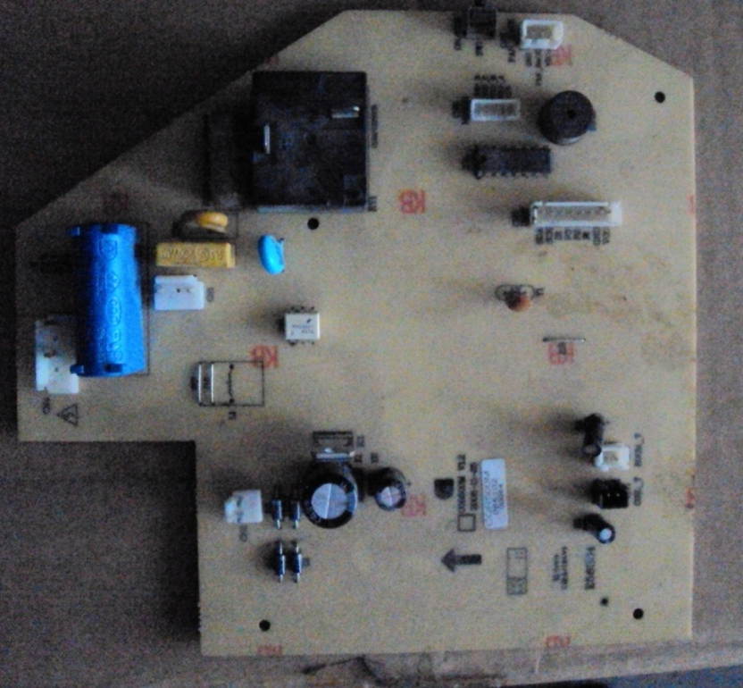
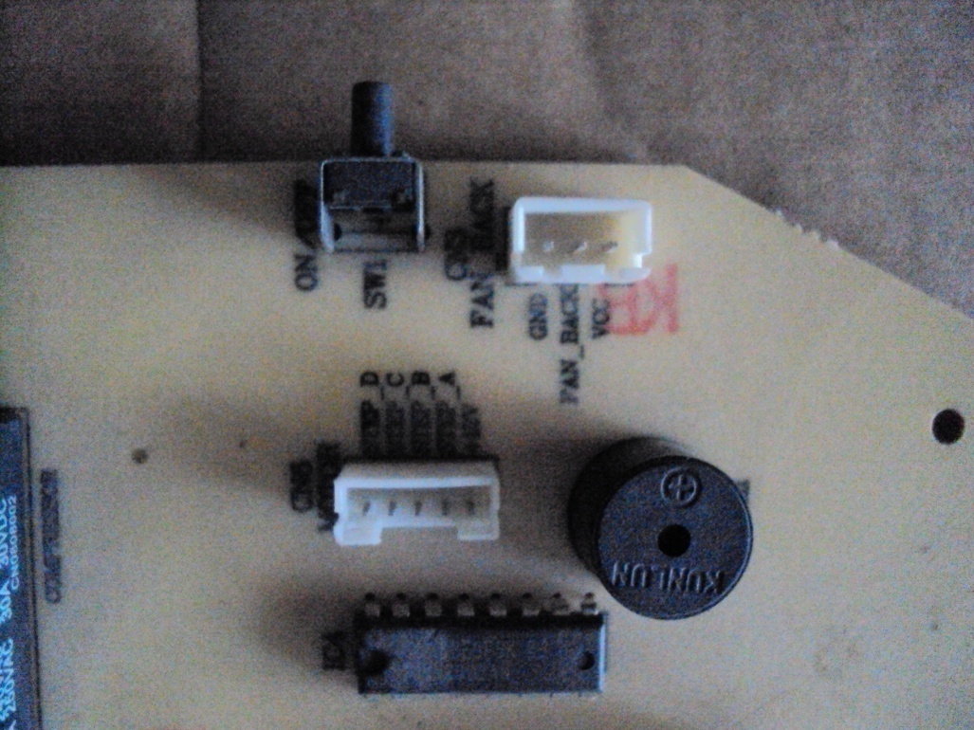
F6 Or H6 Error in SAC
Motor Feedback connector ( 3 Pin)
Includes Vcc, Feedback & Gnd. ( Check 5V between Vcc & Gnd )
Can Be Due to:-
Motor Wires Cut
Feedback wires cut
Motor Jam ( Feedback signal not received)
Track Burn on PCB ( Feedback not reach to MICON
Faulty Connector of Feedback.

Slide 14
THANKYOU

